Slide 1


CV PROJECT
Presented by Mihir Gune

Slide 2
OVERVIEW
Problem Statement
Evaluating the model
Methodology
Results
Building dataset
Conclusion
Training the model
Learnings

Slide 3

PROBLEM STATEMENT
This project aims to develop a robust bullseye detection system using computer vision and deep learning

Slide 4
METHODOLOGY
a)Building a custom dataset
b)Training the YOLO V8 model
c)Evaluating the model on basis of IoU and maP
d)Conversion to optimized format(ONNX, tensorflow)

Slide 5
BUILDING DATASET
First, I decided to use the Custom dataset which I found in ROBOFLOW which gave me readymade dataset with annotations
After that, it was time to make my own dataset, I collected about 120 images and then annotated it using CVAT annotation tool

Slide 6
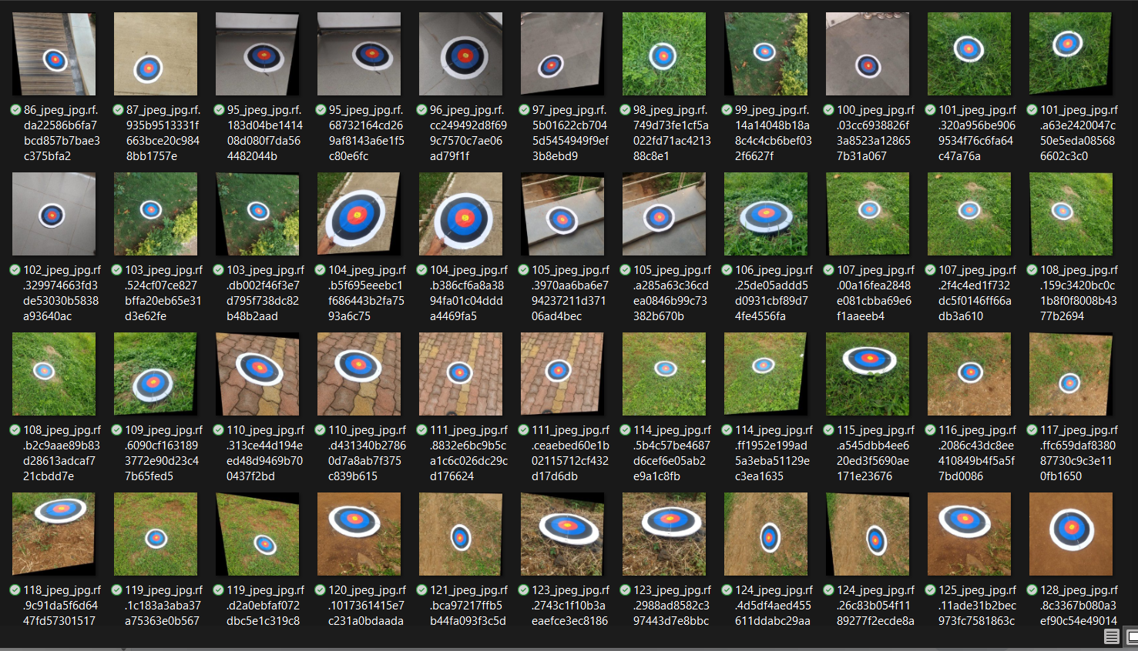

Slide 7
TRAINING THE MODEL
After building the dataset, it was time to train the model. I decided to use the YOLOv8 architecture for this task. I decided to train two separate models:
a) One model trained on the Roboflow dataset
b) Another model trained on the custom dataset I created

Slide 8
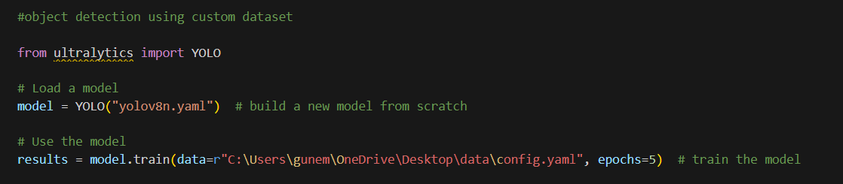
SOME CODE SNIPPET

Slide 9
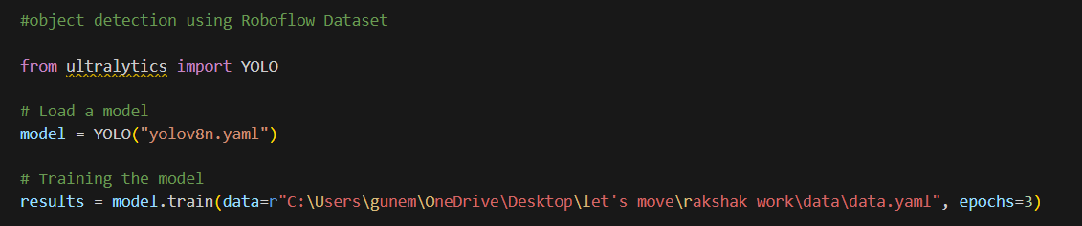

Slide 10
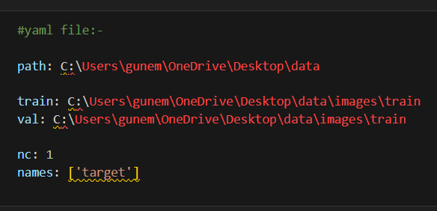
THE YAML FILE

Slide 11
EVALUATING THE MODEL
After training the model , it was time to evaluate the model . For evaluating the model we use two different metrics:-
a)mAP@0.5
b)mAP@0.5:0.95
Again, we will do it for both the roboflow dataset and custom dataset
mAP@0.5 calculates the mean Average Precision at IoU 0.5
Meanwhile,mAP@0.5:0.95 mean AP averaged over IoU from 0.5 to 0.95

Slide 12
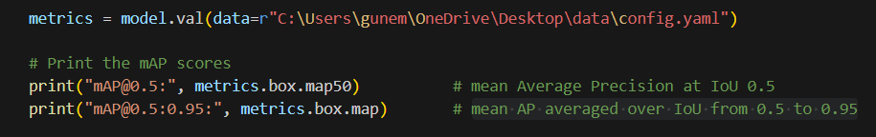
CODE SNIPPETS

Slide 13
RESULT
For ROBOFLOW dataset, (after 3 epoch)
a)mAP@0.5 :- 0.148
b)mAP@0.5:0.95 ;- 0.0515
For Custom dataset, (after 5 epoch)
a)mAP@0.5 :- 0.00409
b)mAP@0.5:0.95 ;- 0.00148

Slide 14
CONCLUSION
Finally, the trained model was converted to the optimized ONNX format for faster and more efficient inference, especially on edge devices
Increasing the number of images in the dataset can lead to improved mAP and IoU, as the model learns better with more diverse and representative data.
The detection performance is directly influenced by the size and diversity of the training dataset. Limited data in the custom dataset likely caused underfitting, whereas the larger Roboflow dataset helped the model generalize better.

Slide 15
LEARNINGS
We learned how to create your own custom dataset by collecting images and annotating it using CVAT
We learned how to train the YOLOv8 model using this custom made dataset
After training the model , we also learned how to evaluate the model using maP(mean average precision) and IoU(intersection over union)
Exporting the model into an ONNX format

Slide 16
Thank You

